Slide 1

Inferring the interplay between network structure and market effects in bitcoin
New journal of physics 16 (2014)
DáNiel kondor, istván csabai, jános szüle, márton pósfai & gábor vattay
BY: Sanjif rajaratnam

Slide 2


Presentation overview
1.0 Paper Overview
2.0 Bitcoin Background Information
3.0 Methodology
4.0 Data Mining
5.0 Extracting the core network
6.0 Detecting Structural Changes
6.1 Daily Snapshots: Weighted Adjacency Matrix
6.2 Principal Component Analysis (PCA)
7.0 Key Results
8.0 Relation to MIE1512H Research Project
9.0 References
Notes:
Overview of paper
Background information
Where they got there data,
how’d they prepare their data for analysis
how the analyzed their data
Key results
And the relationship to my research project for this course

Slide 3
1.0 Paper Overview
Research Question
“Aim to identify relevant changes in network structure over time and to uncover the relation of network structure and macroeconomic indicators of the system”
Data
Bitcoin’s Transaction Network
Procedure
Unsupervised identification of important features in the variation of the network over time
Analytical Method
Principal Component Analysis (PCA)
[1], [2]
Notes:
The main research question this paper attempts to answer..
They answer this question by using Bitcoin’s transaction network
To perform unsupervised identification of important features in the network variation over time
The main analysis method that they use to analyze their data is..

Slide 4

2.0 bitcoin background information
Digital currency
Decentralized
No central governing authority
Finite Currency
Bitcoins are produced via “mining”
Mining rewards half every 210,000 blocks
Transparent
General ledger in the form of a Blockchain available to all users
Anonymous users
Bitcoin accounts are anonymous ‘addresses’
Users can have multiple addresses to protect their identity
Notes:
Now I will provide some background on the Bitcoin currency.
Form of cryptocurrency that is created and held electronically
Decentralized
No one controls it
Every machine that mines BC make up the network so no one person has power over the network
The currency isn’t printed and is produced by people and computers around the world solving mathematical problems
Finite currency
Finite amount of Bitcoin available so people can’t produce more to de-value the currency
Bitcoins are rewarded to miners for “mining” blocks using computational power
This network of “miners” also process transactions made with Bitcoin, making it a standalone payment network.
To cap the Bitcoin limit, the mining reward halves every 210,000 blocks
Transparent
Bitcoin stores details of every single transaction that every happened on the network in a general ledger in the form of a blockchain
Everyone knows how much Bitcoins is owned by one address
Anonymous Users
Bitcoin users are identified via addresses but one user can have multiple addresses to protect their identity

Slide 5
3.0 Methodology
Using the Bitcoin transaction network,
Find the core network of the system
Construct daily snapshots of transactions for the core network
Combined the daily snapshots into a matrix
PCA to identify key features in the evolution of the network over time
Analyze the results
Notes:
General overview of the main methodology that was employed in this paper
They first extracted the core network of active users from the Bitcoin network over 2 years
They then constructed daily snapshots of transactions for the core network
The daily snapshots were then combined into a matrix
Finally, for analysis, Principal Component Analysis was performed on this matrix to identify the key features in the evolution of the network over time
The results were then analyzed to identify network changes the relationship between the network structure and the exchange rate
This methodology will be elaborated on throughout this presentation

Slide 6
4.0 Data mining
Source: Bitcoind
Bitcoin Daemon
Command-line interface for Bitcoin
Data:
Entire list of transactions for 2012/2013 on March 3, 2014
Schema:
Sending addresses
Receiving addresses
Value sent
Time of transaction
Notes:
Their data was acquired from a slightly modified version of the open-source bitcoind client
They collected the entire list of transactions for 2012/2013 on March 3, 2014
The schema of the data the collected included:
The sending address
the receiving address
the value sent
the time of the transaction.

Slide 7
5.0 Extracting the core network
Contraction of graph
Identify addresses belong to the same user using a simple heuristic method
Identify 2 active cores :
Long Term (LT) Core
>100 individual transactions
>60 days
All Users (AU) Core
2000 most active users
Exclusions
Users associated with the Satoshi gambling site
Notes:
They first extracted the active core from the bitcoin transaction network to remove unnecessary information
To contract their graph, they first identified all the transactions with multiple inputs and then they assumed that if multiple addresses were involved in the same transaction, they belonged to the same user
They justified this assumption because users needed an account’s private key to use an account in a transaction
They then identified 2 active cores within the contracted graph
The first was identified as the long term core which corresponded to users that were involved in >100 individual transactions and active for greater than 60 consecutive days
The second was identified as the all users core and it consisted of the 2000 most active users
They excluded any user that was associated with the Satoshi gambling site
because they were considered statistical outliers
not related to the normal operation of the Bitcoin network.

Slide 8
6.0 detecting structural changes
Goal:
Compare successive daily snapshots of the active core with PCA to extract import changes in the graph structure
Daily Snapshot:
A weighted adjacency graph, where the weight of a link is equal to the number of transactions that occurred between node u and v.
Technique:
PCA to determine significant basis vectors on a matrix of concatenated daily snapshots
Notes:
- The next went on to extract the important structural changes from the graph by comparing successive daily snapshots using PCA.
- To do this they constructed a weighted adjacency matrix for each day, converted the matrix into a vector, and concatenated all the days’ vectors into one matrix.
- Then they then ran PCA analysis to identify the significant basis vectors.

Slide 9
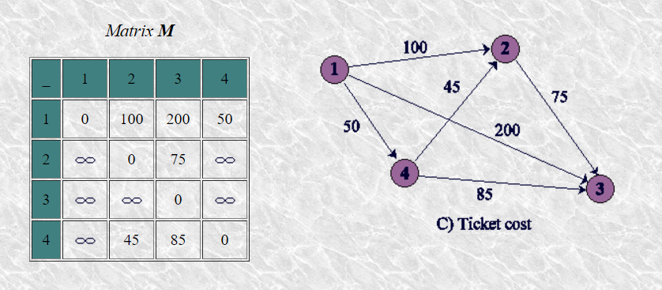
6.1 Daily Snapshot: Weighted adjacency matrix
Weighted adjacency graph
Weight: Number of transactions between users (nodes)
Rearrange each daily snapshot into vectors
Concatenate all daily snapshot vectors into a matrix
Notes:
To further elaborate on the daily snapshot:
A weighted adjacency matrix was constructed for each day with all the nodes as columns and rows.
The weight was equivalent the number of transactions between the nodes.
For example, here user 1 had 1000 transactions with user 2, 200 with user, 3 and 50 with user 4
The generated matrix was rearranged into a vector and all the daily snapshot vectors were concatenated to create a matrix

Slide 10
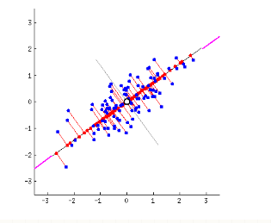
6.2 Principal component analysis (PCA)
Dimensionality Reduction Technique
Purpose: Choose new features in the form of basis vectors that can accurately explain the variance in the dataset
Goal: Maximize variance and minimize projection error
[1], [2], [8], [9]
Notes:
The matrix was analyzed using Principal Component Analysis
PCA is a dimensionality reduction technique
The purpose of this technique is to extract the most important information from the given data set.
This is done by finding new features that are linear combinations of existing features that can accurately explain the variance in the data set
By doing this, we can compress the size of the data set by keeping only the important features
The first basis vector will explain as much variance as possible and each subsequent basis vector will explain as much variance left as possible.
For example, in this data set,
The basis vector will be along the center of the data points since variance is maximized in this direction.
Here the basis vector is a linear combination of both x and y
#The direction of the first principal component is given by the first eigenvector of the covariance matrix.

Slide 11
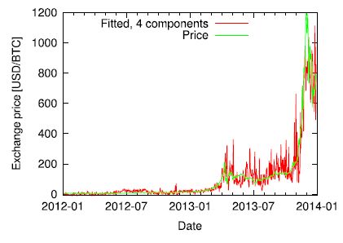
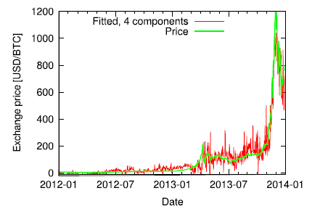
7.0 key Results
Network Covariance
Price Correlation
Notes:
This is the key result they discovered through their analysis
They found a correspondence between the exchange rate time series and the LT core
To calculate the price, they first subtracted the average price from the time series, and estimated this a linear combination of singular vectors.
They could approximate the exchange rate using both the first four base vectors ranked by variance explained, and by the first four base vector ranked by correlation to price.

Slide 12

8.0 relation to mie1512H research project
Research Question
Find the import changes in the network structure over time and see if there is a relationship between the Ethereum network and it’s exchange rate
Data
Ethereum’s Network Structure
Procedure
Unsupervised identification of important features in the variation of the network over time
Analytical Method
Principal Component Analysis (PCA)
Notes:
Now to relate this back to my project for this course
The Ethereum network is very similar to the Bitcoin network that I described earlier. It has the same information in terms of transactions.
The same research question could be answered but in terms of the Ethereum network
PCA can be done to identify the key features involved in the network structure changing
The network structure can also be compared to the Ethereum exchange rate to see if there is any correlation.

Slide 13
The end
Questions?

Slide 14
9.0 References p.1
[1] Kondor, Daniel, et al. “Inferring the Interplay between Network Structure and Market Effects in Bitcoin.” New Journal of Physics, vol. 16, no. 12, Feb. 2014, p. 125003., doi:10.1088/1367-2630/16/12/125003
[2] UofT Logo. Digital image. Wikipedia. Wikimedia Foundation, 21 Feb. 2017. Web. 3 Apr. 2017. <https://en.wikipedia.org/wiki/File:UofT_Logo.svg>.
[3] "Bitcoin Block Reward Halving Countdown." Bitcoin Block Reward Halving Countdown. N.p., n.d. Web. 03 Apr. 2017. <http://www.bitcoinblockhalf.com/>.
[4] Bitcoin Logo. Digital image. Bitcoin. Bitcoin Project, n.d. Web. 3 Apr. 2017. <https://bitcoin.org/img/icons/opengraph.png>.
[5] "What Is Bitcoin?" CoinDesk. N.p., 28 Aug. 2015. Web. 3 Apr. 2017. <http://www.coindesk.com/information/what-is-bitcoin/>.
[6] "Newest 'bitcoind' Questions." Newest 'bitcoind' Questions. Stack Exchange, n.d. Web. 3 Apr. 2017. <http://bitcoin.stackexchange.com/questions/tagged/bitcoind>.

Slide 15
9.0 References p.2
[7] "Section 5.3: Matrix Representation of Graphs." Section 5.3: Matrix Representation of Graphs. University of Arkansas, n.d. Web. 3 Apr. 2017. <http://cpsc.ualr.edu/srini/DM/chapters/review5.3.html>.
[8] Abdi, Herve, and Lynne J. Williams. "Principal Component Analysis." Introduction to Securitization (2011): 1-12. Semantic Scholar. Wiley Interdisciplinary Reviews: Computational Statistics, 2010. Web. 3 Apr. 2017. <https://pdfs.semanticscholar.org/53b9/966a0333c9c9198cdf03efc073e991647c12.pdf>.
[9] "Making Sense of Principal Component Analysis, Eigenvectors & Eigenvalues." Pca - Making Sense of Principal Component Analysis, Eigenvectors & Eigenvalues - Cross Validated. Stack Exchange, n.d. Web. 04 Apr. 2017. <http://stats.stackexchange.com/questions/2691/making-sense-of-principal-component-analysis-eigenvectors-eigenvalues>.
[10] Ethereum Logo. Digital image. Ethereum. N.p., n.d. Web. 3 Apr. 2017. <https://www.ethereum.org/images/logos/ETHEREUM-LOGO_LANDSCAPE_Black.png>.

